Slide 1
Crowd detection Camera
to Prevent COVID-19
BY
Venu Dammalapati
Dept of Cse – iii-i

Slide 2
Contents
Introduction
Requirements
Devices
Working Principle
Screenshots
Analysis
Future Scope
Conclusion

Slide 3
Introduction
In this time when COVID-19 is spreading rapidly, it is essential to maintain social distance and avoid large public gatherings at one place to break the chain of corona infection.
The authorities need reliable technology that can survey such places to prevent any unnecessary movement.
But maintaining this is not easy. Many people, knowingly or unknowingly, gather and roam on the streets.
Keeping an eye on all these activities is not an easy job. The authorities need reliable technology that can survey such places to prevent any unnecessary movement. Our COVID-19 Crowd Detection Camera can help in isolating the people .

Slide 4
Functional Requirements
Detecting the Persons in the given frame using YOLOv3.
Calculating the distance between each and every person.
Checking whether the distance between two people is acceptable or not.
If the minimum distance was not met then mark that as Social Distance Violation.

Slide 5
Hardware Requirements
Processor
RAM – 8Gb
GPU (Recommended)
Webcam that supports live Streaming

Slide 6
Software Requirements
Python3
Libraries Used
Open CV version 2
NumPy
SciPy

Slide 7
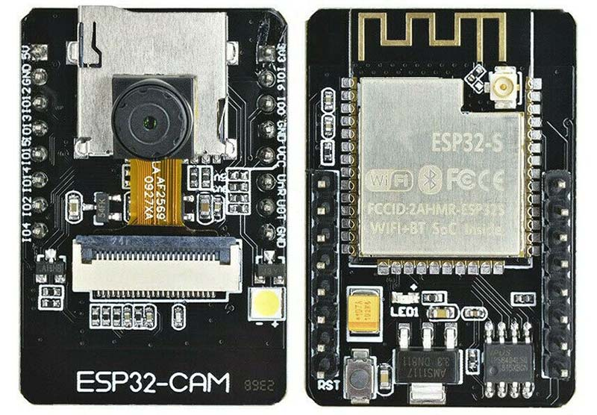
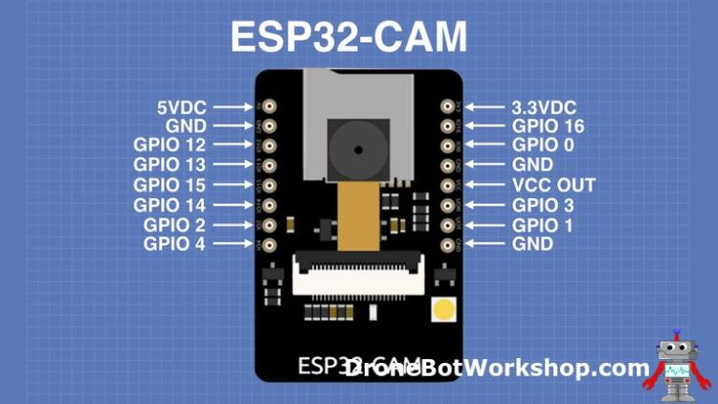
DEVICES: ESP32

Slide 8
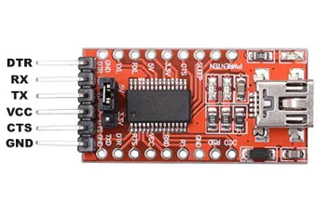
Future Technology Devices International (FTDI)

Slide 9
Working Principle
1. Capture the video frame by frame
Using the cv2.videoCapture() function we capture the frames.
2. Detect the people in the frame.
Using the loop we traverse through the frames captured and using the neural network trained using Coco datasets and yoloV3 algorithm we detect the people.
3. Calculate the distance between the people.
After detecting the people we extract the centroids of the detections. We use cdist() function of SciPy library to calculate the distance between each and every detection. This output will be Stored in a matrix.
4. Identifying social distance violations.
We will set a certain threshold distance. If that threshold distance was not met in between any two persons then we consider that as a social distance violation and alert them.

Slide 10
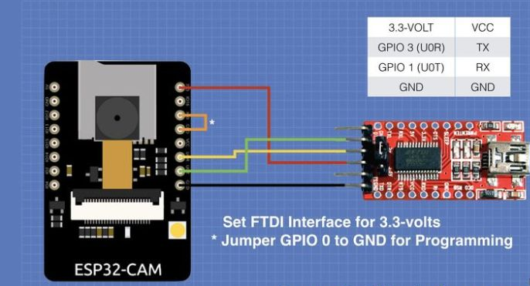
Circuit Diagram

Slide 11
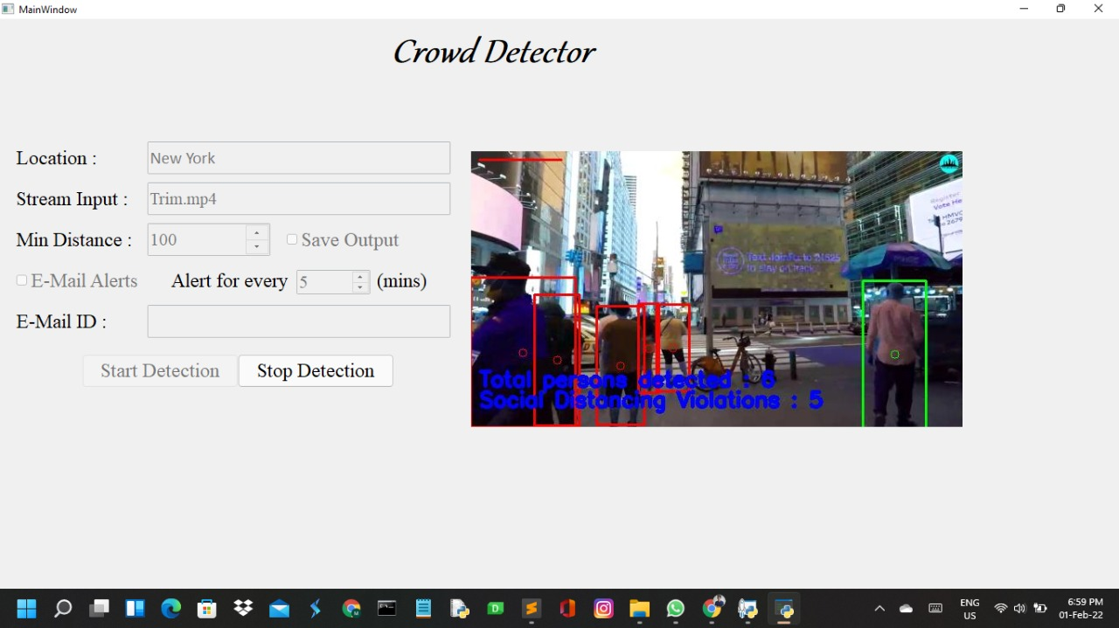
Screenshots

Slide 12
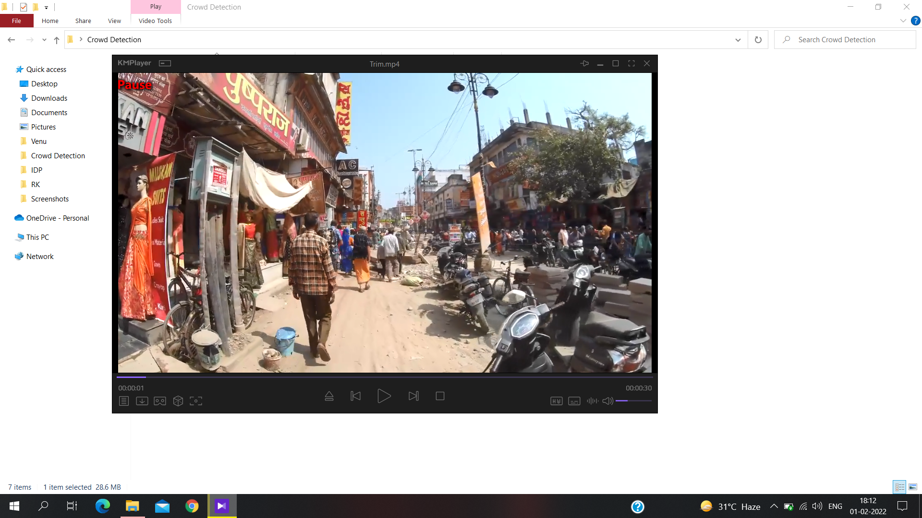
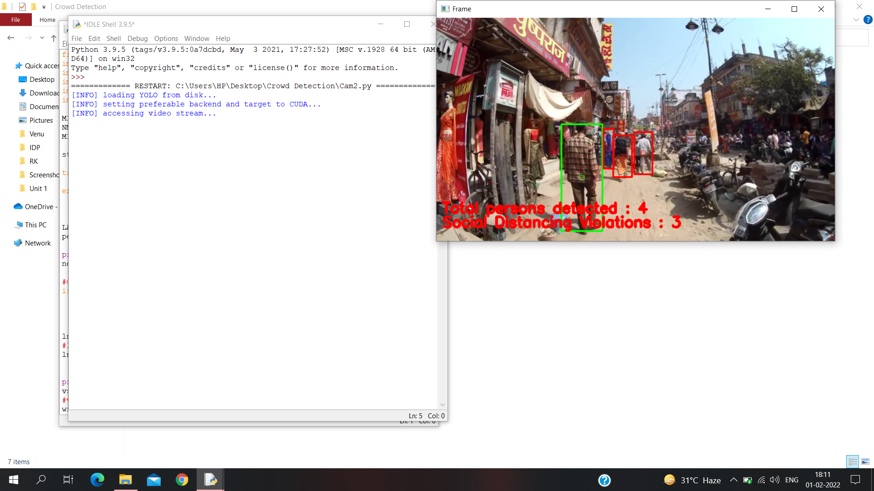

Slide 13
Future Scope
We want to work further on this device by adding it an extra future that is calculating average waiting time in public transport areas like Railway stations, Bus stands .
Estimates wait times from the crowd density levels analyzed/ number of people counted. Displays real-time information of crowd density including estimated queue times on staffs’ PCs (updated in every 1-2 seconds) and the Information Boards for customers (updated in every 1 min).

Slide 14
Real Time Usage
This device can be used in public transport areas
Public gathering places
House hold areas or parks
Offices
Colleges
Schools

Slide 15
Analysis
Using Intel Core – i5 processor and 8Gb RAM
Frame rate : 0.9552977156520088
Using Intel Core – i5 processor and 8Gb RAM with 4Gb GPU Support.
Frame rate : 2.4148818087406587

Slide 16
Advantages
Detect high traffic on roads.
Identify any unauthorized human entry in a restricted area.
Observe the number of people in a hall/auditorium.
Maintain and monitor the flow of the crowd in a protest demonstration.

Slide 17
Conclusion
Since many of the public places were deployed with the Surveillance cameras we can make use of that feed to alert the gatherings. This approach can be a fruitful one.

Slide 18
References
1. Object Detection,
https://www.youtube.com/playlist?list=PLKHYJbyeQ1a0oGzgRXy-QwAN1tSV4XZxg
2. Interface:
https://www.youtube.com/playlist?list=PLzMcBGfZo4-lB8MZfHPLTEHO9zJDDLpYj
3. ESP32 Camera and FTDI Connections:
https://dronebotworkshop.com/esp32-cam-intro/

Slide 19
THANK YOU

